Slide 1
SPAWAR S-100 Testbed Report
Presented by SPAWAR
April 2018

Slide 2
S-100 Testbed Status
Phase 1
Phase 2
Phase 3
Phase 4
Phase 5
Phase 6
Phase 7
Phase 8
Phase 9
Create Feature and Portrayal Catalogues
Simple Production Tool (S-57 data convertor)
Simple Viewer
Preliminary Production Tools
Create Updates
Preliminary Data Validation & Packaging
Shore Based ECDIS
Full Production Tools
Full Data Validation and Packaging
Full ECDIS

Slide 3
S-100 Testbed Development
Current viewer available on Basecamp
Supports XSLT and Lua based portrayals
Preliminary S-101 Lua portrayal catalogue available on Basecamp
Notes:
Preliminary catalogue does not conform to Part 50 / Part 9A

Slide 4
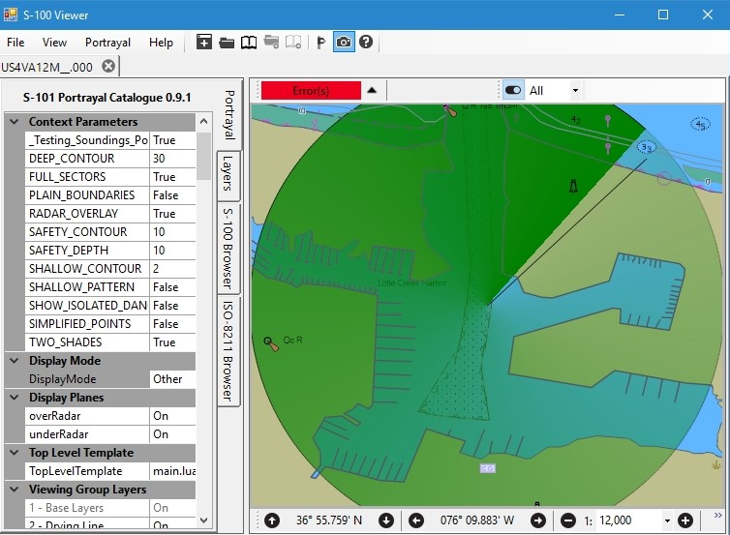
S-100 Testbed Phase 3 SPAWAR S-100 Viewer
Feature Catalogue Browser
Encoded Dataset Browser (tabular)
ISO-8211, GML (future), HDF5 (future)
S-100 Dataset Browser (tabular)
Encoded dataset -> S-100 general data model
Validates against feature catalogue
Portrayal
XSLT and Lua
Interact with settings exposed by portrayal catalogue
Monitor size calibration
Zoom / Pan / Rotation
Mercator / Lambert Conformal / Polar Stereographic

Slide 5
S-100 Testbed Development Challenges
Configuration Control
Ensure use of current (published) and / or latest (developmental) files via central repository
S-100Base.xsd, S100CI.xsd, S100FC.xsd, S100FD.xsd
Portrayal schemas
Product schemas
Test datasets, exchange sets, etc.
Exchange Set schemas
Notes:
Challenges are not unique to us – all manufacturers and S-100 product developers
Need automated discovery to support rapidly changing datasets

Slide 6
S-100 Testbed Development Challenges
Exchange Sets
Needed for implementation and testing
Some metadata only exists in the exchange set
Encryption / Compression / Signatures
Automated data discovery and import
Associates datasets / feature catalogues / portrayal catalogues
Notes:
Need automated discovery to support rapidly changing datasets

Slide 7
S-100 Testbed GML Update: S-123
Attribute multiplicity does not agree with feature catalogue
Invalid attributes - generally a result of typos or incorrect case
[JS.RDOSVC.99] attribute [transmissionContent] contains 18 value(s), but must contain no more than 1 value(s)
Encoding of enumerated types is inconsistent
Part 10 should specify how enumerations are to be encoded for each encoding
Examples
ISO8211 uses the numeric value of the enumeration
Attribute enum failed lookup: [RadioServiceArea], id= [JS.RDOSVC.72], value= [NBDP Telegraphy]
Validation Issues
XSLT Portrayal expects the numeric value of the enumeration
Notes:
When encoding an enumerated type within a dataset we recommend using the numeric value vice the label (string).
NBD Telegraphy (Narrow Band Direct Printing Telegraphy).

Slide 8
S-100 Testbed GML Update: S-412
Examined S-412 prototype dataset
Encountered issues consistent with those encountered in S-123 and other GML encoded datasets
Will re-evaluate when prototype is updated to match changes to Part 10-b
Notes:
When encoding an enumerated type within a dataset we recommend using the numeric value vice the label (string).
NBD Telegraphy (Narrow Band Direct Printing Telegraphy).

Slide 9
S-100 Testbed HDF5 Update
Insufficient detail in Part 10-c
Unlike ISO-8211, the mapping from a Part 10-c encoding to S-100 concepts cannot be easily inferred
Provided feedback on draft
Met with S-102 developers
10-c should describe a standard way to represent null
We currently don’t support the Coverage spatial model
Coordinate changes to Part 10-c with S-102 and S-111 WGs to ensure encoded datasets and feature catalogues align
Investigating using GML Coverage schema
Notes:
S-100 concepts: Feature model, spatial model, application schema / feature catalogue

Slide 10
S-100 Lua Portrayal Documents
Submitted S-100 Part 50 (Lua Based Scripting)
Adds generalized scripting support to S-100
Updating S-100 Viewer to support scripting functions
Submitted S-100 Part 9A (Lua Based Portrayal)
Uses Part 50 to implement portrayal rules
Updated S-100 Viewer to support drawing instructions
Redlining Part 50 and Part 9A
Using updates to S-100 Viewer implementation to identify issues
Currently only minor changes to Part 9A
Will provide redlines upon completion
Notes:
Implementing scripting functions as needed (most are not needed by portrayal)
ACTION: Will provide redlines when complete

Slide 11
S-100 Testbed Lua Portrayal
Implemented Lua portrayal optimizations supporting analysis of performance issues discussed at TSM 5
Modified portrayal output schema (drawing instructions) to enhance performance
Implemented simple portrayal cache
Modified to better support pre-generated portrayal
No rendering optimizations
Notes:
Implementing scripting functions as needed (most are not needed by portrayal)
Action: Update S-100

Slide 12
S-100 Testbed Portrayal Issues
S-100 4a-D, S100_SupportFileFormat
S-52 specifies areas, followed by lines, points, and text
Add explicit direction to S-100 Part 9
Ordering of drawing instructions with equivalent display priority
Exchange set support for Lua files
Add “LUA”
Notes:
The following XSLT generated drawing instructions do not allow for proper portrayal when the chart is rotated:
AugmentedRay
AugmentedPath:ArcByRadius
AugmentedPath:Annulus
The issue occurs when the feature to be portrayed does not share a common CRS for all elements of an augmented drawing instruction. For instance, when drawing SectorLight leg lines, the portrayal may output:
<augmentedRay>
<featureReference>5155</featureReference>
<viewingGroup>27070</viewingGroup>
<displayPlane>OVERRADAR</displayPlane>
<drawingPriority>24</drawingPriority>
<crs>LocalCRS</crs>
<lineStyle>
<intervalLength>5.4</intervalLength>
<pen width=".32">
<color>CHBLK</color>
</pen>
<dash>
<start>0</start>
<length>3.6</length>
</dash>
</lineStyle>
<direction>53</direction>
<length>25</length>
</augmentedRay>
Note that the CRS must be shared by the direction and length of the ray. However, when the chart is rotated, the length requires LocalCRS (assuming FULL_SECTORS is off), but the direction requires GeographicCRS so that the line rotates with the chart. Using different CRS values for direction and length is not possible with the current schema.

Slide 13
S-100 Testbed Portrayal Issues
Certain XSLT augmented drawing instructions do not allow for proper portrayal with a rotated chart
AugmentedRay
Only one CRS is available for all elements of each augmented drawing instruction
Update XSLT Drawing Instructions Schema
AugmentedPath:ArcByRadius
AugmentedPath:Annulus
Example
SectorLight leg lines FULL_SECTORS off
<augmentedRay>
Direction should be GeographicCRS
Length should be LocalCRS
…
<crs>LocalCRS</crs>
…
<direction>53</direction>
<length>25</length>
</augmentedRay>
Notes:
The following XSLT generated drawing instructions do not allow for proper portrayal when the chart is rotated:
AugmentedRay
AugmentedPath:ArcByRadius
AugmentedPath:Annulus
The issue occurs when the feature to be portrayed does not share a common CRS for all elements of an augmented drawing instruction. For instance, when drawing SectorLight leg lines, the portrayal may output:
<augmentedRay>
<featureReference>5155</featureReference>
<viewingGroup>27070</viewingGroup>
<displayPlane>OVERRADAR</displayPlane>
<drawingPriority>24</drawingPriority>
<crs>LocalCRS</crs>
<lineStyle>
<intervalLength>5.4</intervalLength>
<pen width=".32">
<color>CHBLK</color>
</pen>
<dash>
<start>0</start>
<length>3.6</length>
</dash>
</lineStyle>
<direction>53</direction>
<length>25</length>
</augmentedRay>
Note that the CRS must be shared by the direction and length of the ray. However, when the chart is rotated, the length requires LocalCRS (assuming FULL_SECTORS is off), but the direction requires GeographicCRS so that the line rotates with the chart. Using different CRS values for direction and length is not possible with the current schema.

Slide 14
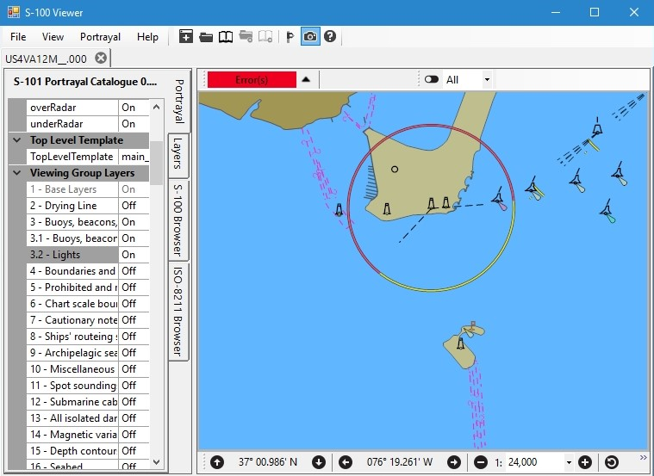
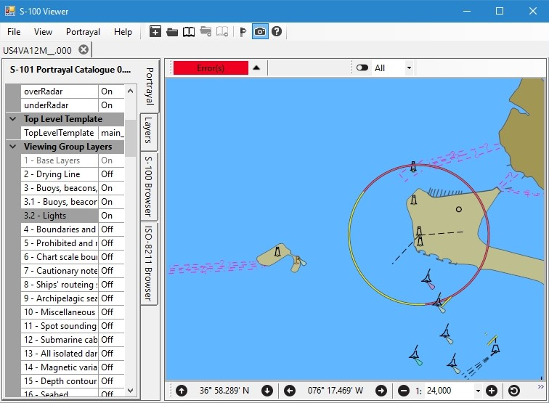
S-100 Testbed Portrayal Issues
North Up
Local & Geographic CRS relative to 0
West Up
Local from 270, Geographic from 0
Notes:
The following XSLT generated drawing instructions do not allow for proper portrayal when the chart is rotated:
AugmentedRay
AugmentedPath:ArcByRadius
AugmentedPath:Annulus
The issue occurs when the feature to be portrayed does not share a common CRS for all elements of an augmented drawing instruction. For instance, when drawing SectorLight leg lines, the portrayal may output:
<augmentedRay>
<featureReference>5155</featureReference>
<viewingGroup>27070</viewingGroup>
<displayPlane>OVERRADAR</displayPlane>
<drawingPriority>24</drawingPriority>
<crs>LocalCRS</crs>
<lineStyle>
<intervalLength>5.4</intervalLength>
<pen width=".32">
<color>CHBLK</color>
</pen>
<dash>
<start>0</start>
<length>3.6</length>
</dash>
</lineStyle>
<direction>53</direction>
<length>25</length>
</augmentedRay>
Note that the CRS must be shared by the direction and length of the ray. However, when the chart is rotated, the length requires LocalCRS (assuming FULL_SECTORS is off), but the direction requires GeographicCRS so that the line rotates with the chart. Using different CRS values for direction and length is not possible with the current schema.

Slide 15
S-100 Testbed Portrayal Issues Date Dependent Portrayal
Issues apply to Lua and XSLT
Implementing Date Dependent selector(s) poses challenges
A mariner selected date, such as the current date
A date range
Selector must be able to represent:
Current portrayal requires regeneration whenever a date dependent selector is changed
Products may require users make frequent changes to date selectors
There is no way to specify the following as default values for context parameters
The current date and/or time
The date and/or time of creation or modification

Slide 16
S-100 Testbed Portrayal Issues Date Dependent Portrayal
Granularity of “Date” context parameter may be insufficient
Granularity of one day
Future products may require more granularity
Consider required granularity
Part 9 context parameter enumerated type “Date” is unclear
OPTIONS:
Reference an ISO or S-100 date type in enumeration comments
Provide a context parameter type capable of expressing a date or date range in a standard format
Provide date / date range in the drawing instruction(s) (similar to line suppression) so that portrayal does not require periodic regeneration
S-100 4a-5.6.4 “Data and Date Time Information”

Slide 17
S-101 Lua Portrayal Implementation
Unimplemented Features (symbols unavailable)
BuoyEmergencyWreckMarking CollisionRegulationLimit
DiscolouredWater OffshoreWindTurbine
PhysicalAisAidToNavigation PilotageDistrict
textPlacement VesselTrafficServiceArea
VirtualAisAidToNavigation
Notes:
Missing symbols are due to new features for S-101
Data is unavailable to test even if symbols were available

Slide 18
S-101 Lua Portrayal Implementation
Feature types intentionally not portrayed (portrayal outputs a NullInstruction)
DeepWaterRoute
IslandGroup
TrafficSeparationScheme
LocalDirectionOfBuoyage
Only generates the arrow; need to implement circles
Notes:
Container types for other features – no associated spatial
LocalDirectionOfBuoyage red and green circles are missing

Slide 19
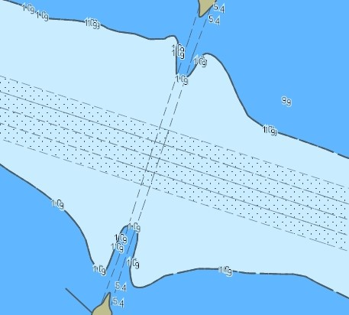
S-101 Lua Portrayal Implementation
DEPCNT03 (contour labels)
Verify drawing priority
Placed on each curve segment – should be on each curve
Notes:
The following XSLT generated drawing instructions do not allow for proper portrayal when the chart is rotated:
AugmentedRay
AugmentedPath:ArcByRadius
AugmentedPath:Annulus
The issue occurs when the feature to be portrayed does not share a common CRS for all elements of an augmented drawing instruction. For instance, when drawing SectorLight leg lines, the portrayal may output:
<augmentedRay>
<featureReference>5155</featureReference>
<viewingGroup>27070</viewingGroup>
<displayPlane>OVERRADAR</displayPlane>
<drawingPriority>24</drawingPriority>
<crs>LocalCRS</crs>
<lineStyle>
<intervalLength>5.4</intervalLength>
<pen width=".32">
<color>CHBLK</color>
</pen>
<dash>
<start>0</start>
<length>3.6</length>
</dash>
</lineStyle>
<direction>53</direction>
<length>25</length>
</augmentedRay>
Note that the CRS must be shared by the direction and length of the ray. However, when the chart is rotated, the length requires LocalCRS (assuming FULL_SECTORS is off), but the direction requires GeographicCRS so that the line rotates with the chart. Using different CRS values for direction and length is not possible with the current schema.

Slide 20
S-101 Lua Portrayal Implementation
Symbols associated with chart updates such as CHRVDEL1 are not output by portrayal.
Manufacturer should generate drawing instructions and render along with the portrayal output
Notes:
Missing symbols are due to new features for S-101

Slide 21
S-101 Lua Portrayal Implementation IEC 61174 Required Selectors
Chart Boundary
How does this differ from “Chart scale boundaries”?
Portrayal Catalogue provides viewing group 21030
Chart Scale Boundaries
Manufacturer must generate drawing instructions
Portrayal Catalogue provides viewing group layer 6
Highlight date dependent
Recommend adding a separate viewing group for the date dependent symbol CHDATD01
Viewing group layer vs. viewing group?
If implemented via context parameter will require portrayal regeneration on each change
Notes:
Selectors == context parameters / viewing groups
Add viewing group for CHDATD01, otherwise portrayal must be regenerated each time the context parameter is changed

Slide 22
S-101 Lua Portrayal Implementation IEC 61174 Required Selectors
Supplementary Information / Highlight Info (INFORM / NINFOM)
Implement portrayal rules for INFORM01
Discrepancy between S-101 viewing group 31030 “Supplementary Information” vs IEC 61174 “Highlight Info”
Additional Documents / Highlight Document (TXTDSC, NTXDS, PICREP)
Implement portrayal rules
S-101 C2.8.4.1.3 viewing group 31031 is deleted; required by IEC 61174
Should viewing group 31031 be provided? (Currently it is not)
Recommend harmonizing naming
Recommend harmonizing naming

Slide 23
S-101 Lua Portrayal Implementation IEC 61174 Required Selectors
National Language
Add context parameter
Update Lua rules to evaluate context parameter
Safe Depths Shown
Recommend providing separate viewing groups for safe vs. unsafe soundings
Recommend adding both to viewing group layer 11 (Spot Soundings)
If implemented via context parameter will require portrayal regeneration on each change
Date Dependent
Addressed earlier in this presentation

Slide 24
Conclusion
S-101 Lua portrayal is nearing completion
Provided on Basecamp when updated to Part 50 / Part 9a
Updates / clarifications to GML encoding are improving dataset conformance to S-100
Next viewer may support GML
S-100 support for gridded products using HDF5 needs further refinement

Slide 25
Summary of Recommendations
Repository for S-100 schemas, catalogues, test datasets, etc.
Provide S100_ExchangeSet and associated test data
Consistently encode enumeration types within GML and HDF5
Update GML dataset(s) to resolve validation errors
Provide updated GML datasets which conform to the latest updates to Part 10-B
Continue work on 10-C provide detail needed to map HDF5 to S-100 application schema
Standardize encoding of null attributes within HDF5 datasets
Update Part 9 to explicitly state ordering for drawing instructions with the same priority
Incorporate "Part 50" and "Part 9a" into S-100
Add "LUA" to S100_SupportFileFormat
Provide SVG symbols for new S-101 features so that they can be symbolized by portrayal
Provide guidance within S-101 on implementing portrayal of chart scale boundaries

Slide 26
Summary of Recommendations
Add an S-101 viewing group for CHDATD01 named "Highlight Date Dependent"
Harmonize S-101 and 61174 regarding name of viewing group 31030
Verify whether S-101 C2.8.4.1.3 should provide viewing group 31031
If so, harmonize name
Add S-101 viewing groups for safe & unsafe soundings
Add both to viewing group layer 11
Viewing group for safe soundings meets 61174 selector requirement for "Safe depths shown".
Review the S-101 Lua Portrayal Catalogue implementation and provide feedback
Modify Part 9 drawing instruction schemas to allow for correct XSLT portrayal of rotated charts
Agree on a required granularity for date dependent features
Provide a context parameter type representing a date or date range
Provide a mechanism to specify default values for Date context parameters
Investigate modifying portrayal drawing instructions to contain date info

